Slide 1

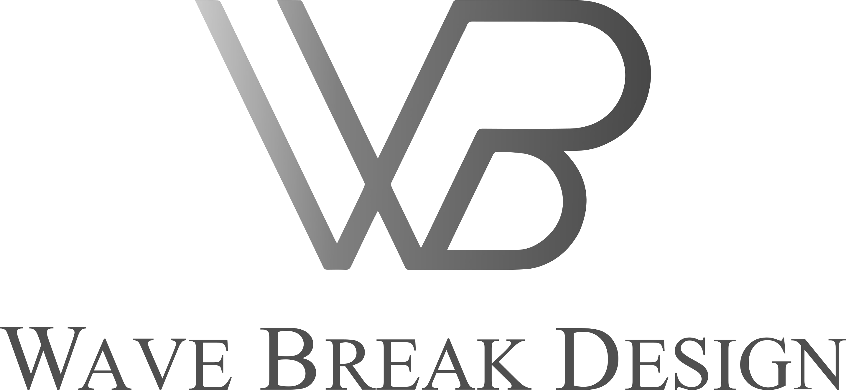

PRESENTATION
2022

Slide 2

CONTENTS
ABOUT US………………………………………………………………..…....................................................................................
WHO WE CAN HELP ………………………………………………………………………………………………………………...………….
OUR MISSION, OUR VISION, OUR VALUES ………………………………………………………………..…….....…….
PROBLEM ……………………………………………………….…………………………………………………………………………...…………..
SOLUTION ………………………………………………………………………………………………………………………………………………...
BUSINESS SERVICE PRICES ……………………………………………………………………………………………..……………….
BUSINESS STARTUP COST ………………………………………………………………………………………...…….……………….
MARKETING PLAN ……………………………………………………………………………………………………………………………….…
OPERATIONAL BUSINESS MODEL ……………………………………………………………………………....……………….…
COMPETITORS ………………………………………………………………….……..…………………………………………………………….
ORGANIZATION CHART…………………………………………………………….…………………….....………………………………
FOUNDER ...........…………………………………………………………….……………………...............…….....................................
CONTACTS ...........…………………………………………………………….…………………….....................................................
03
04
05
06
07
18
19
20
22
23
24
25
26

Slide 3


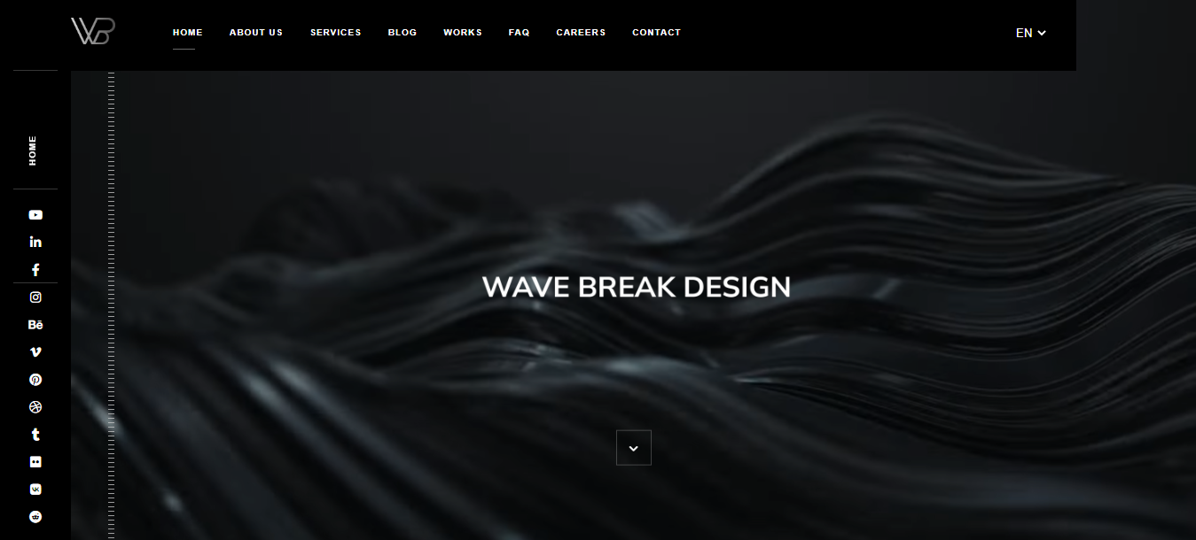
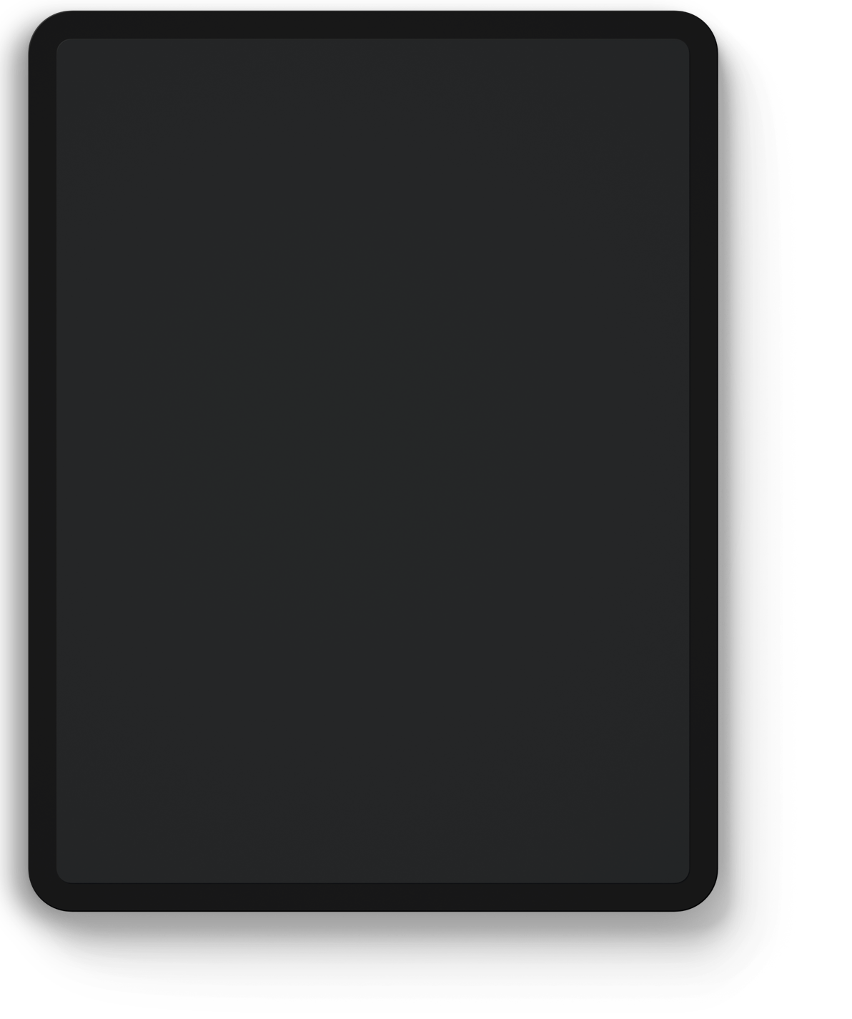
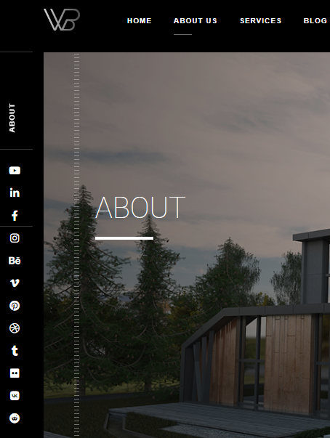
ABOUT US
We a real estate visual design and 3D digital strategy agency providing innovative and high-end digital solutions based on the latest interactive technologies. We specialize in design, 3D architectural visualization, animation, modeling, virtual reality (VR), augmented reality(AR), mixed reality (MR), and branding development.
We deliver intelligent, multi-disciplinary design solutions, to cater to marketing campaigns and planning applications, across residential, commercial, hospitality, destination, and all other sectors, worldwide and deliver discreet individual solutions covering brand strategy, content, and a variety of production.

Slide 4
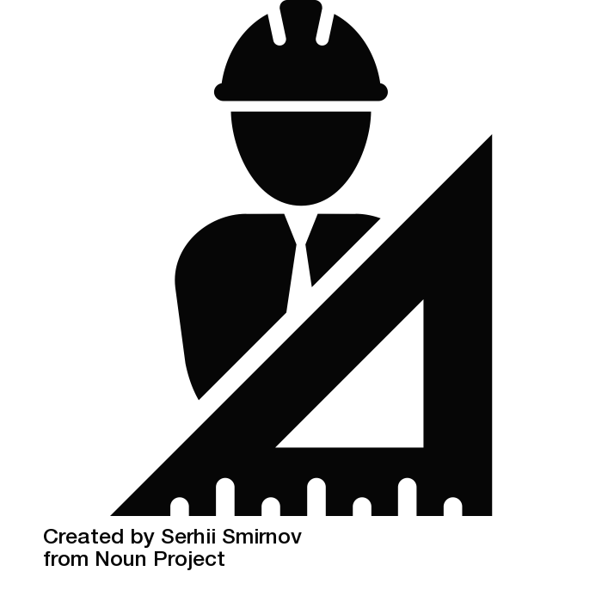
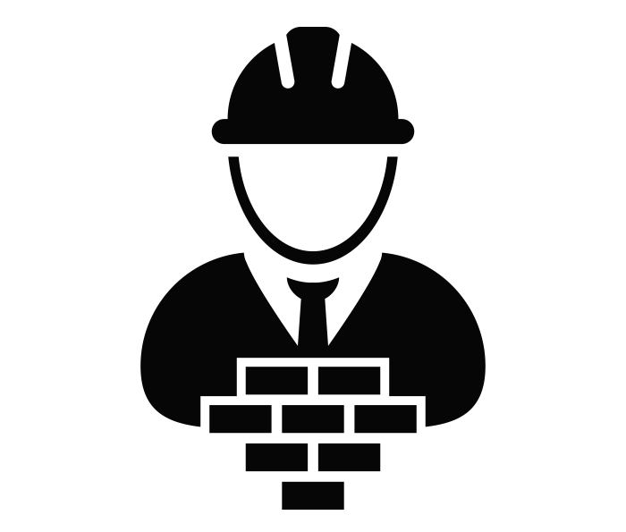
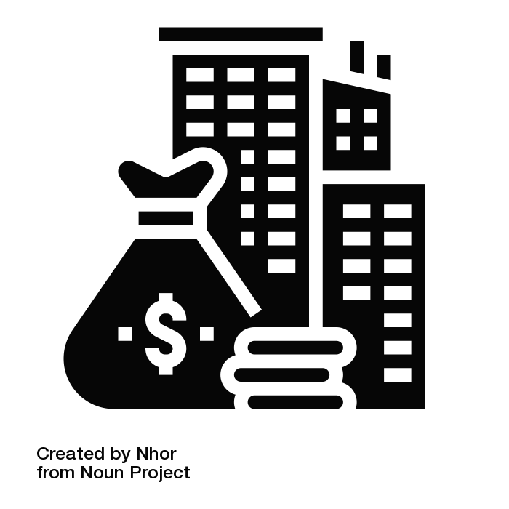
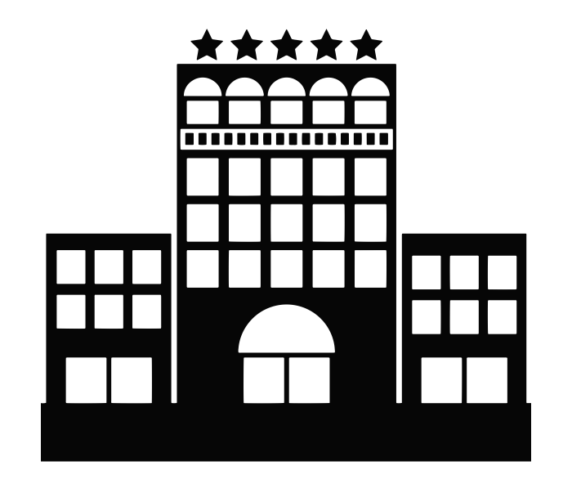
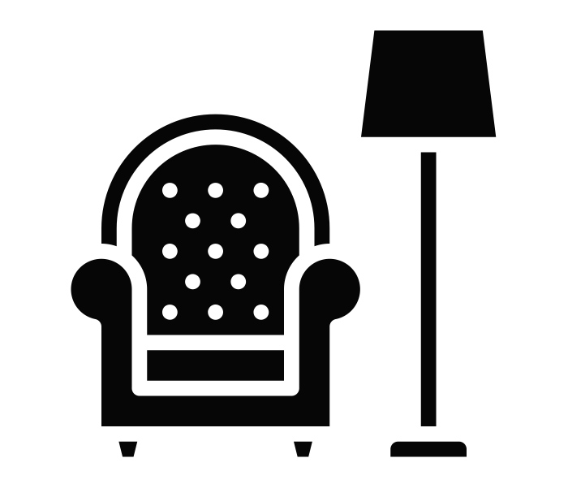
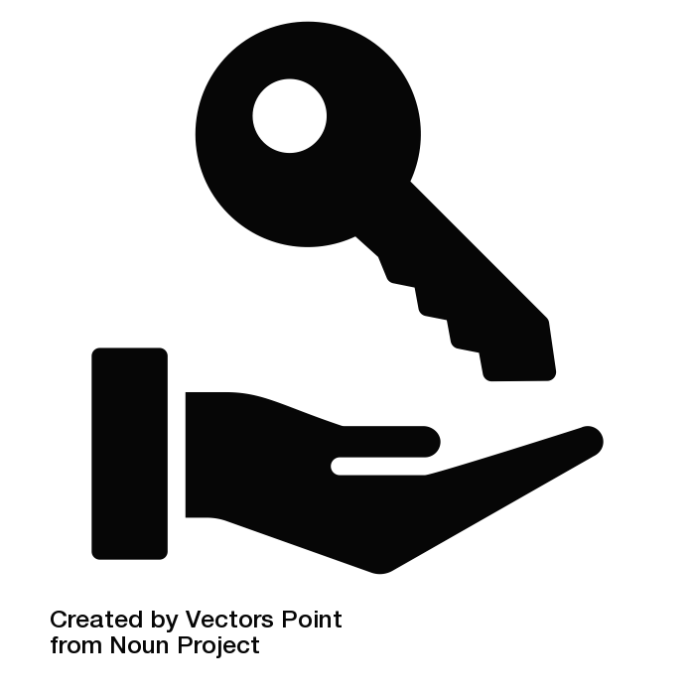
WHO WE CAN HELP
2.91%
1.25%
5.61%
5.55%
6.73%
10%
Architects &
Interior Designers
Contractors
Real Estate
Developers
Chained-Brand
Hotels
Furnishing
Manufacturers & Retailers
Homeowners &
Homebuyers

Slide 5



O U R M I S S I O N
O U R V A L U E S
Our mission is to "break" standard rules in the real estate industry and create an extra new value a real estate, by combining new interactive technologies and 3D visualization solutions for marketing strategy. This is the key to developing innovations, efficiency, sales, and quality, and a new identity within the architectural visualization marketplace while will continue to foster innovation and profitability.
The Achievement.
Disappointment isn't deadly: It is the fortitude to proceed with that matters. It is smarter to fall flat in innovation than to prevail in impersonation.
Focus on the customer.
Rather than focusing in on the opposition, center around the client.
Satisfaction.
Happy customers are your biggest advocates and can become your most successful sales team.
O U R V I S I O N
Effortlessness is a virtuoso.
Virtuoso is simplifying complex thoughts, not simplifying thoughts complex.
Testing.
To raise the standard in the interactive 3D context and to be the company that creates incredible results for clients.
We guarantee that all design and marketing service offerings and related techniques have been developed based on a careful selection of tried-and-tested industry concepts and procedures.

Slide 6
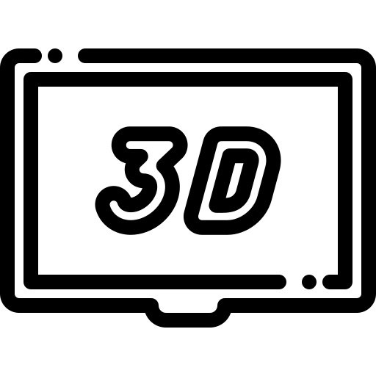




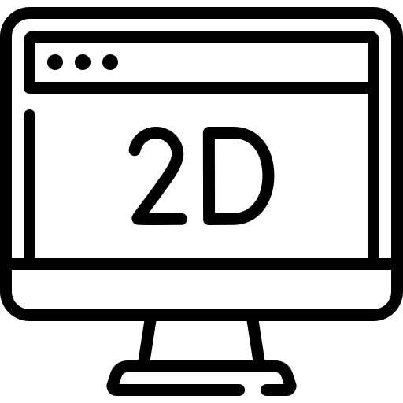



PROBLEM
Problem 1
Problem 2
Problem 3
The first main problem in this a fast
pace media-driven 21st-century business world is time. For example, 3D visualization vs Traditional Photography/videography.
Providing a high level of service or smile
is not enough if companies want to make customers feel encouraged to buy. Development of strategic retail spaces
Most people have that can't imagine a project just looking in 2D images. They can't get to see the depth and dimensions of the design. They might not understand all the intricacies of a complex,
Problem 4
Problem 5
Problem 6
The changes clients are asking for aren't the only things need to work on. There could be other problems that can spot before the construction of the project begins.
Do you know how expensive it can get to edit a design? The problem is that editing a 2D blueprint is neither quick nor easy.
3D visualization enhance marketing. Speaking of marketing, 3D visualization goes a long way in boosting advertising. Customers can't put a 2D blueprint in a commercial.
Problem 7
Problem 8
Problem 9
There is a problem with submitting large projects because it requires a lot of memory, but it is also important that quality is not compromised.
In these times of competition, it is increasingly difficult to stand out and compete with other companies. Everyone wants smart solutions to improve and grow their business.
The Wave Break Design wants to be a company that offers services from the creation of an initial concept to finalizing marketing strategies.

Slide 7
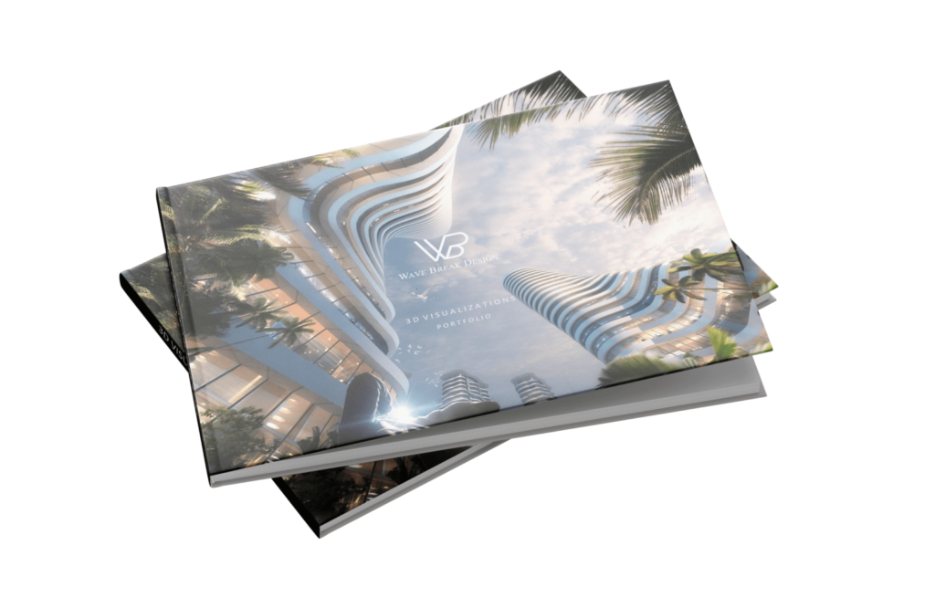
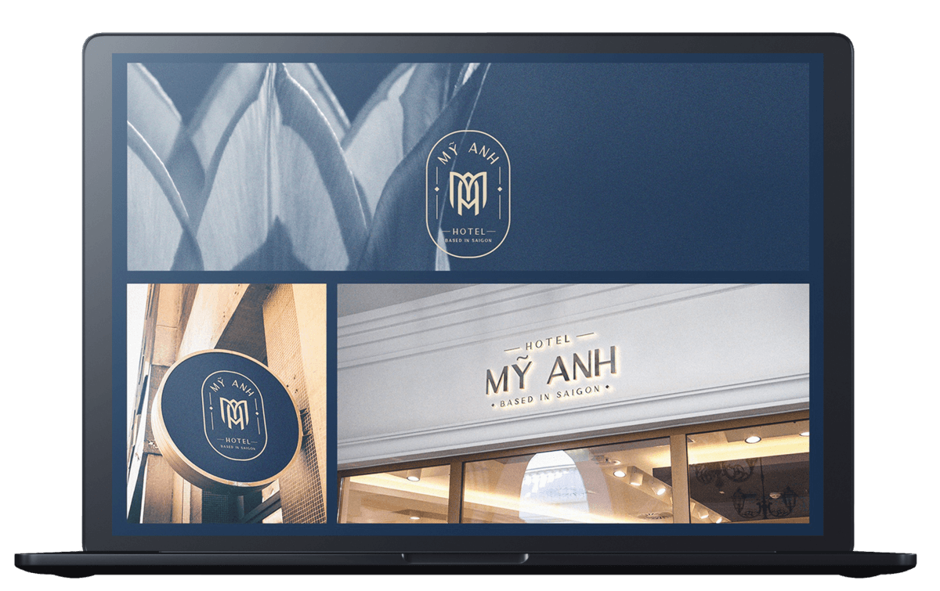


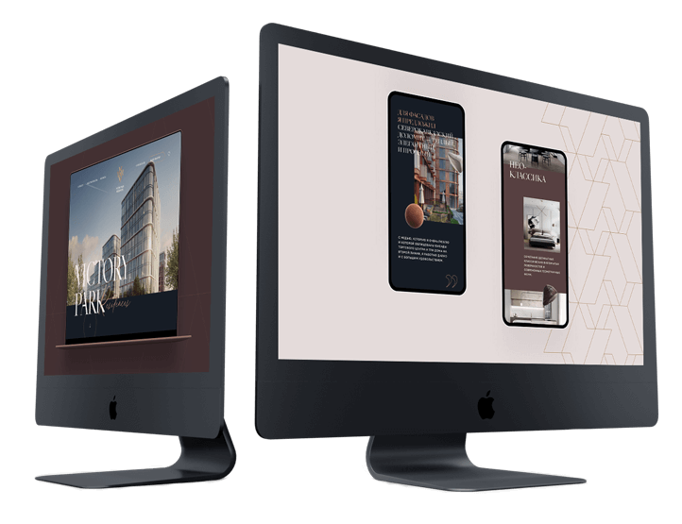
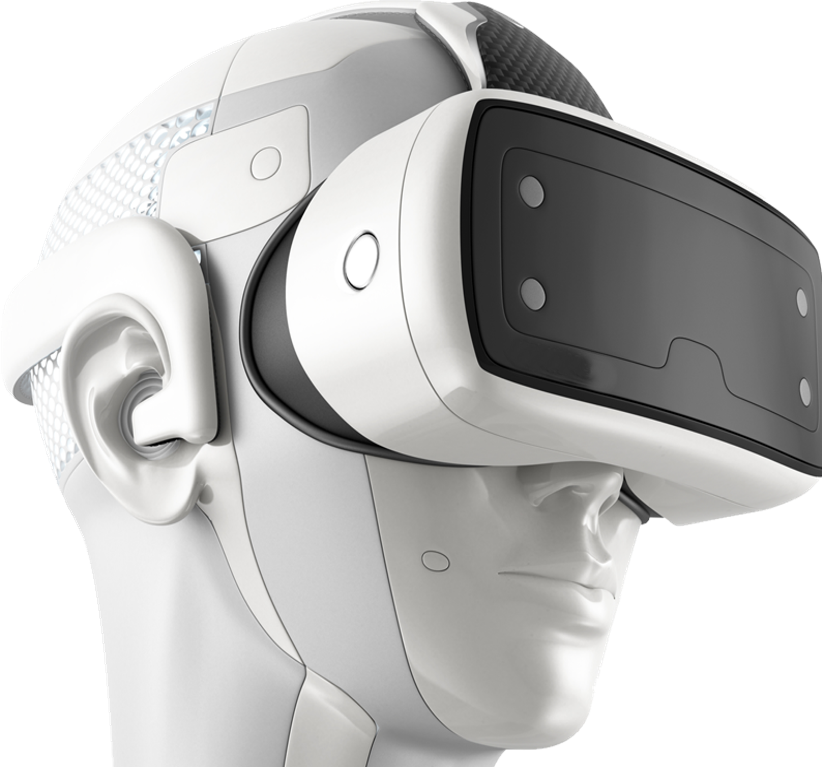
SOLUTION
{[{
EXTERIOR & INTERIOR DESIGN
3D MODELING
3D VISUALIZATION
{[
[
BRANDING & DESIGN
XR TECHNOLOGIES

Slide 8
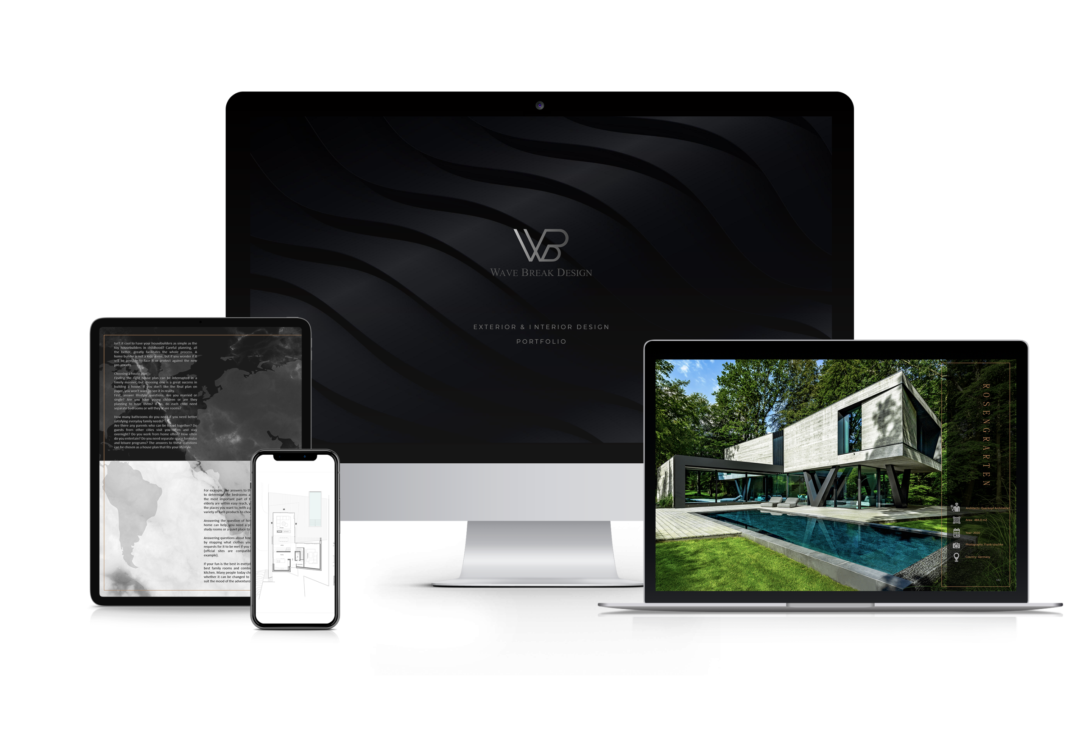




Exterior & Interior
Design
Design is a plan or specification for the construction of an object or system or for the implementation of an activity or process, or the result of that plan or specification in the form of a prototype, product or process.
In architecture and interior design, branded environments extend the experience of an organization's brand, or distinguishing characteristics as expressed in names, symbols and designs, to the design of interior or exterior physical settings. Cohesive and strong branding is the first step in a successful product, is an important aspect of creating a focused and comfortable space for retailers and businesses. It offers a powerful way to introduce visitors and clients prospects to the brand’s unique culture.
PLANNING
SCHEMATIC DESIGN
DESIGN DEVELOPMENT

Slide 9
How Business Can Benefit From Exterior & Interior Design
01
02
03
04
05
06
07
08
09
Creating Creative Marketing Spaces
Good Stewards Of Resources
ADD VALUE
Design Is A Great Resource For Companies And Office Building
Creative Solutions
SEABRIGHT RESIDENCE RENDERING
Development Of Strategic Retail Spaces
One Puts A Focus On Sales And The Other On Design
Designing Spaces With The Home Buyer In Mind

Slide 10
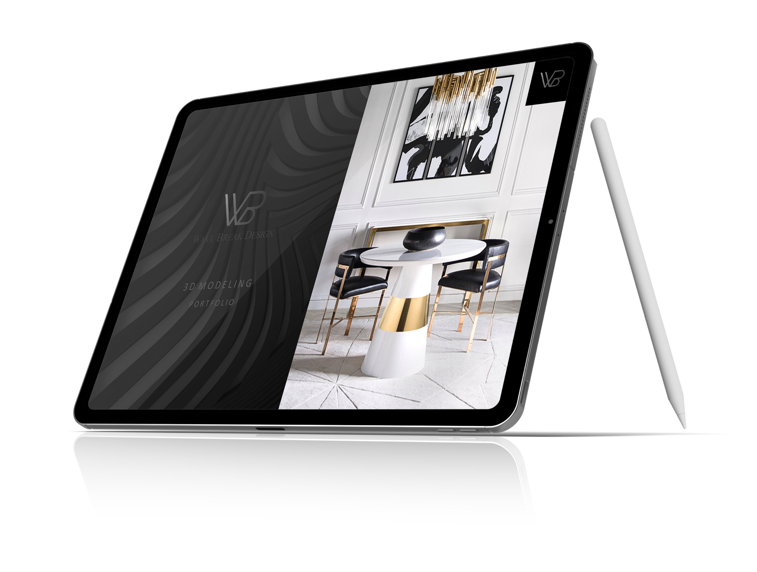
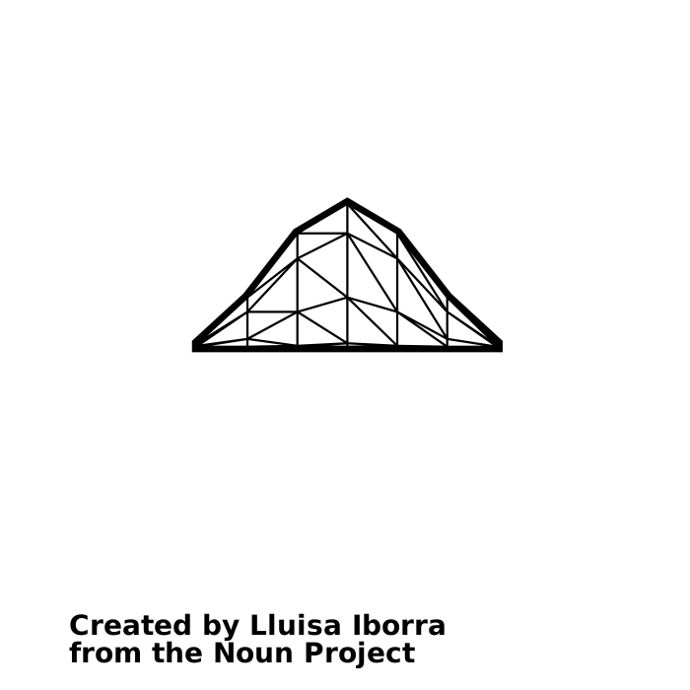
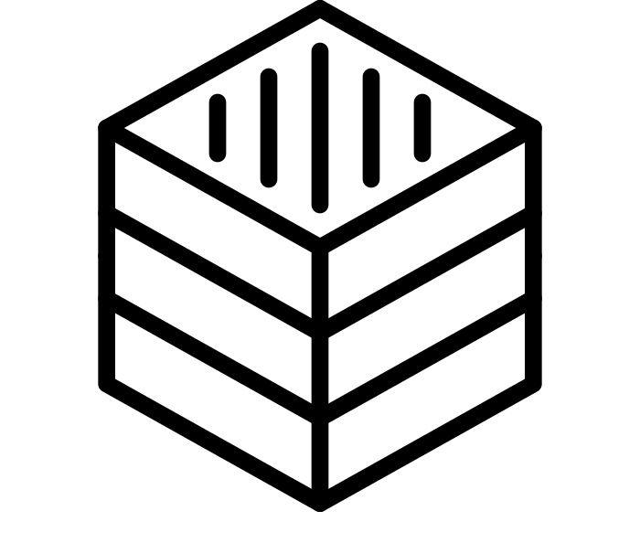
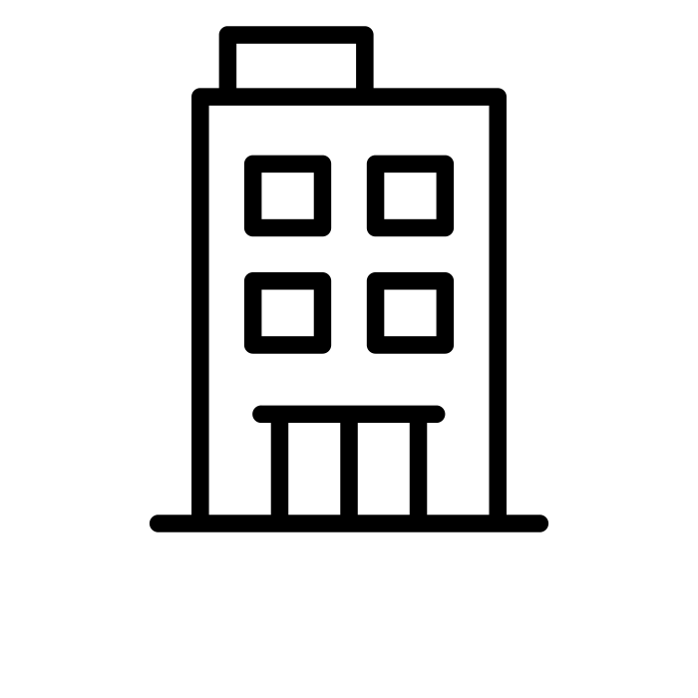
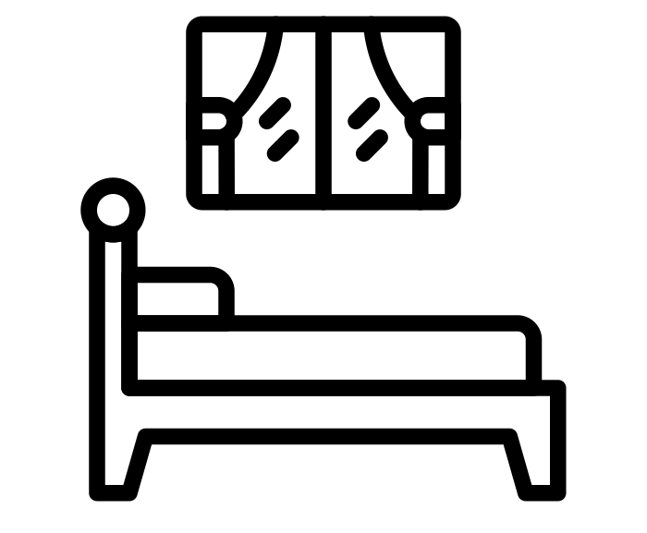

https://wavebreakdesign.com/3d-modeling/
2. 3D Modeling
In 3D computer graphics, 3D modeling is the process of developing a mathematical representation of any surface of an object in three dimensions via specialized software.
3D modeling and texturing are all extremely popular nowadays because such technologies are becoming ever more available now.
Creating a 3D image, whether it’s for production or just animation and rendering, requires creating a 3D file. When creating a 3D model, you need to know where it will be used. Much depends on this factor, such as what rules and constraints should pay attention to model development.
LOW – POLY
3D MODELING
TEXTURES
3D MODELING
ARCHITECTURAL
3D MODELING
INTERIOR
3D MODELING

Slide 11
How Business Can Benefit From
3D Modeling
01
02
03
04
05
06
07
08
09
HELPS OBSERVE AND MEASURE
HELPS TO FIND FLAWS AND LOOPHOLES
SSM & MARKETING RESEARCH
ARCHITECTURAL DESIGN
CONFIGURATORS
HELP GET A SUCCINCT VIEW
PRINT MATERIALS
VIRTUAL PROTOTYPING
HELPS ESTIMATE

Slide 12
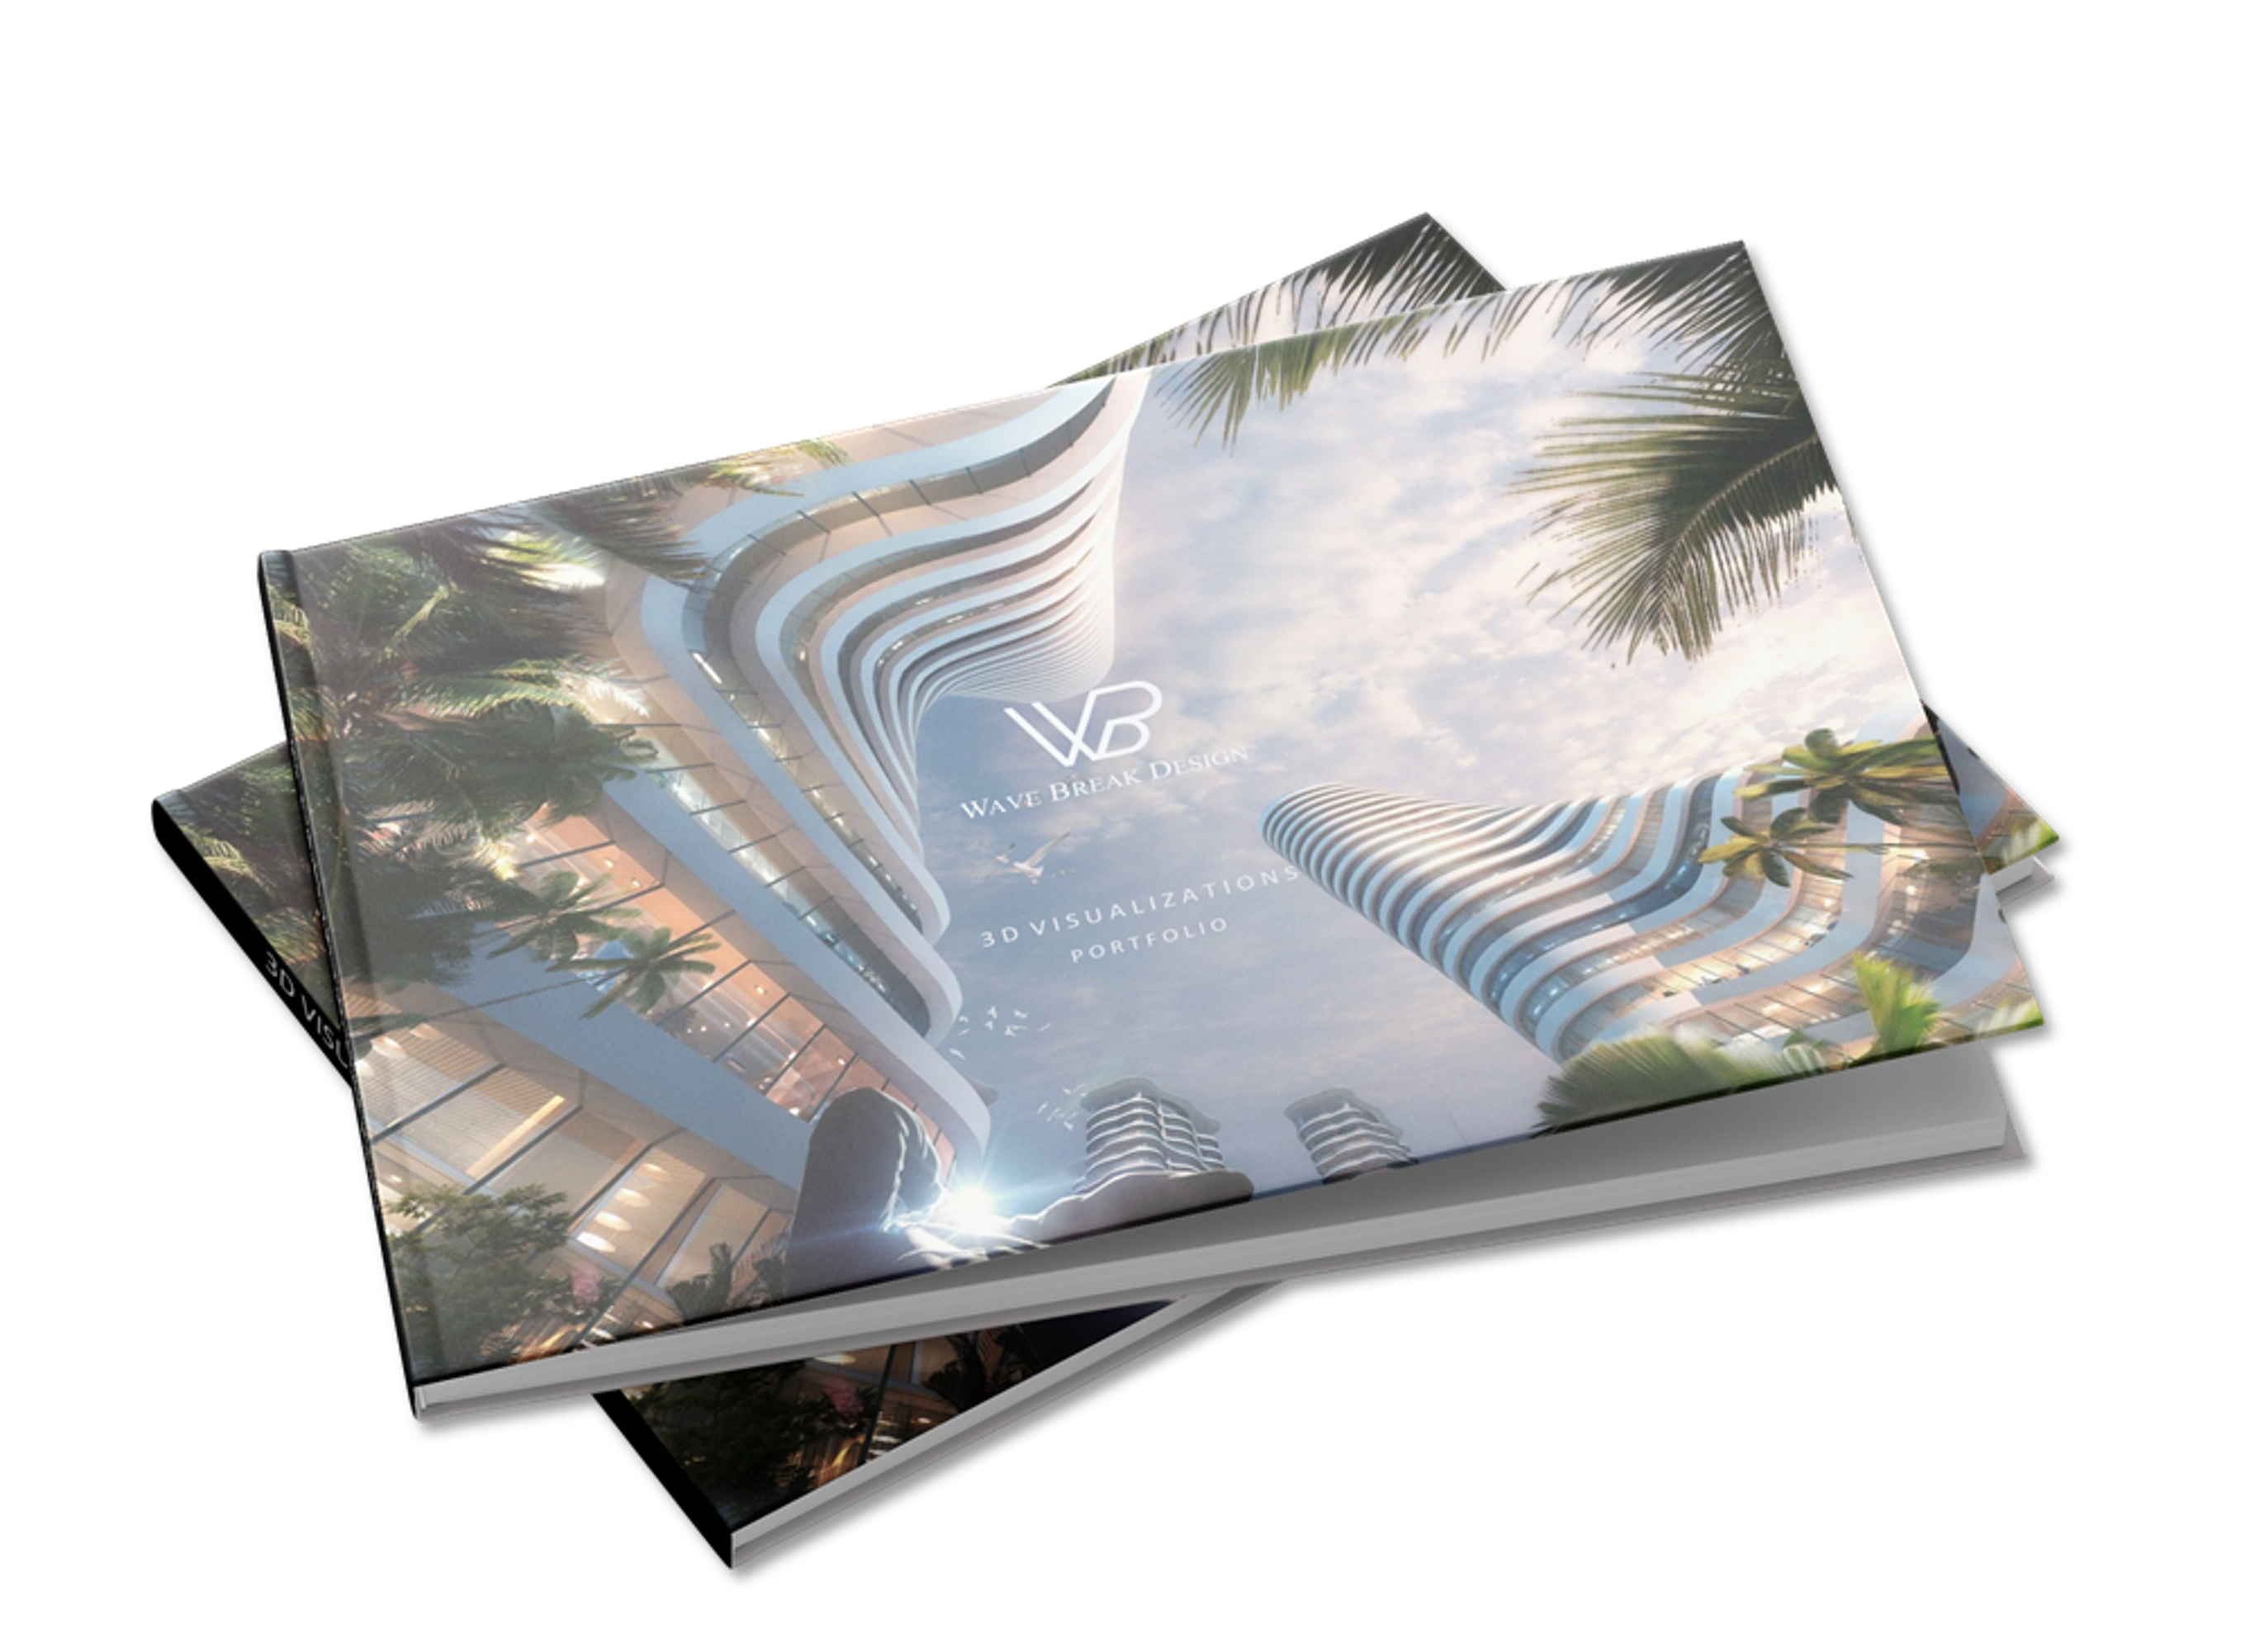
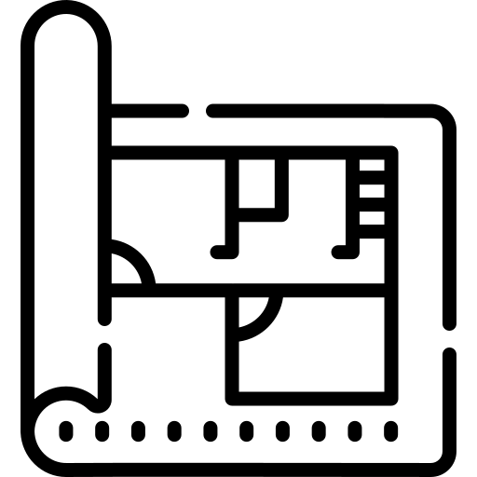
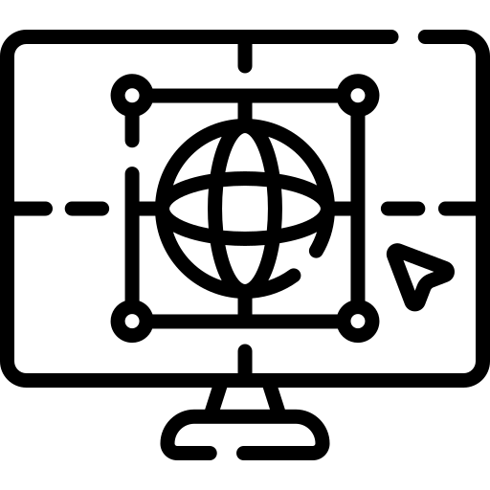
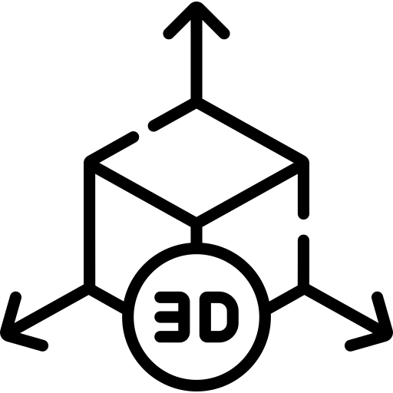
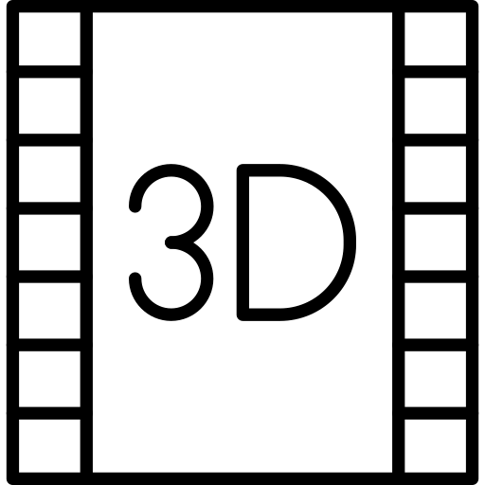
3. 3D Visualization
3D Visualization is defined as “any technique for creating images or animations to communicate a message”.
The real estate market uses a combination of both static and dynamic CGI to contribute to marketing and producing their projects. CGI in this industry is often referred to as models. Although 2D renders are used often, real estate companies prefer using 3D CGI. CGI for commercials are becoming a popular option to create eye-catching material. Modern-day commercials range from CGI product rendering, animated material to mixing both live-action and animation. We work closely and collaboratively with our clients to understand how their products or projects are used, where when, and who the end-users actually are.
ARCHITECTURAL &
INTERIOR 3D IMAGES
PRODUCT
3D IMAGES
ARCHITECTURAL & INTERIOR ANIMATION
3D PRODUCT ANIMATION

Slide 13
How Business Can Benefit From
3D Vizualization
01
02
03
04
05
06
07
08
09
DEIGN PRESENTATION
BOOST CREATIVITY
MORE EFFECTIVE PRESENTATIONS
DESIGN ANALYSIS
FINANCIAL BENEFITS
MARKETING
ENHANCED DECISION MAKING
IMPRESSIVE
IMPROVES COMMUNICATION

Slide 14
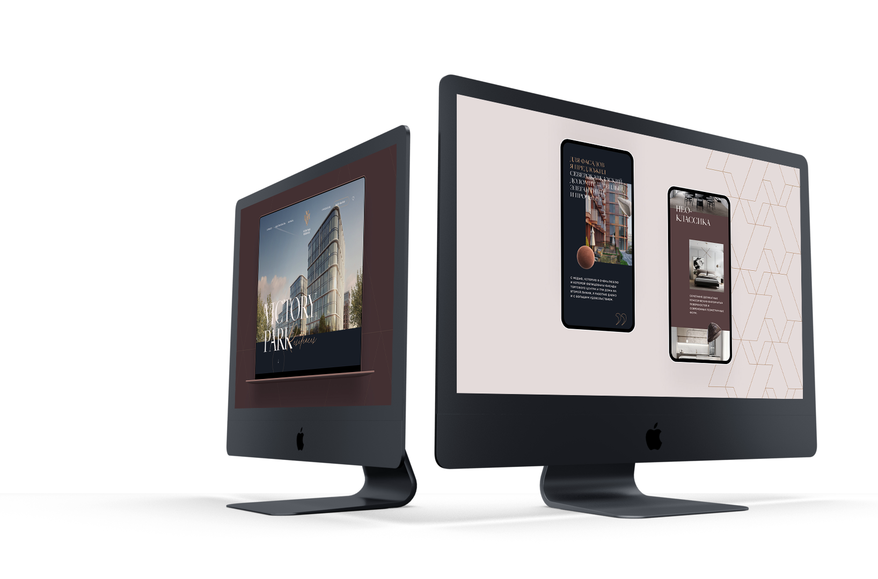
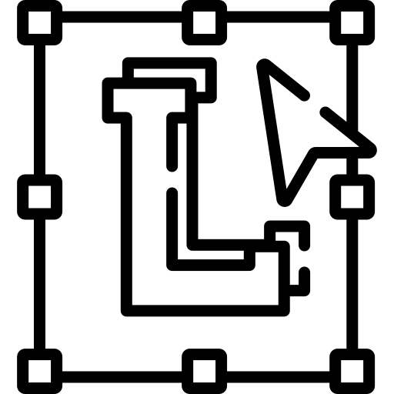



4. Branding & Design
We offer branding & design services to the target audience of Wave Break Design. We create brands to introduce, sell real estate projects or products to companies' audiences.
The brand creates an original concept that, together with professional design services, gives customers an impression and best reflects the companies' business. Also, we offer services to help present corporate identity in a variety of visual and interactive formats because in today's age brand activation is extremely important. It’s the first impression you give to your audience and it’s what makes you stand out among your competition. Your brand is a direct reflection of what your customers should expect from you. It’s your voice, your mission, your marketing materials, your packaging, your website. It’s the reason people will choose you over others. Simply put, branding is not just a logo. For small businesses especially, it’s important to attract and retain loyal customers and branding will do just that.
READ MORE
LOGO &
BRANDING
WEB & APP DESIGN
CUSTOM
DESIGN
BRANDING ENVIRONMENTS

Slide 15
How Business Can Benefit From
Branding & Design
01
02
03
04
05
06
07
08
09
BRANDING YOUR BUSINESS WILL SAVE YOU MONEY AND TIME IN THE LONG RUN
BRANDING HELPS TO ATTRACT YOUR IDEAL CLIENTS
BRANDING LEADS TO RETURNING CUSTOMERS & REFERRALS
BRANDING HELPS YOU STAND OUT IN A SATURATED MARKET
BRANDING LEADS TO CUSTOMER LOYALTY
WITH A CLEAR BRAND, YOU CAN CHARGE WHAT YOU’RE WORTH
BRANDING GIVES YOU A CLEAR STRATEGY FOR MOVING FORWARD
BRANDING = CONSISTENCY
BRANDING GIVES YOU CREDIBILITY

Slide 16




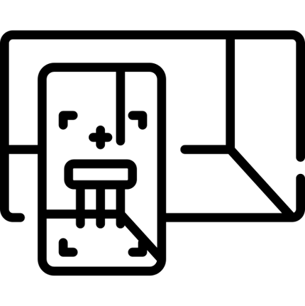
5. XR Technologies
XR makes it possible to let customers explore products or projects in a fun and intuitive manner. With real-time rendering, there are no limitations. It’s a new and interactive way to market, sell and activate.
These Interactive marketing ideas open up avenues in the fields of the Real Estate Industry, for architects, designers, retail companies, construction companies, and homeowners. This is a new approach for the design process that the concepts of interaction and multi-relations are being achieved through it.
3D Interactive environments are often referred to as virtual reality or interactive 3D and have a figurative appearance. Much like our own world, this type of world allows interaction with other (networked) beings as well as the manipulation of objects.
This is a new approach for the design process that the concepts of interaction and multi-relations are being achieved through it.
READ MORE
VIRTUAL
REALITY
AUGMENTED
REALITY
INTERACTIVE SALES
APPLICATIONS
HOLOGRAM
MIXED
REALITY

Slide 17
How Business Can Benefit From
XR Technologies
01
02
03
04
05
06
07
08
09
ALL PROJECTS OFFLINE - VIEWED ANYWHERE
SAVES A LOT OF TIME, SPACE, MONEY, AND ENERGY
LARGE REVIT FILE OPTIMIZATION
CAN BE UTILIZED THROUGHOUT THE DEVELOPMENT CYCLE
DATA AND ANALYTICS ADDITIONS TO AR
USER ENGAGEMENT THROUGH VISUAL INTERACTION
IT HELPS TO ENGAGE CUSTOMERS
DIRECT RETURN ON INVESTMENT
HELPING ESTIMATE THE TOTAL COST

Slide 18


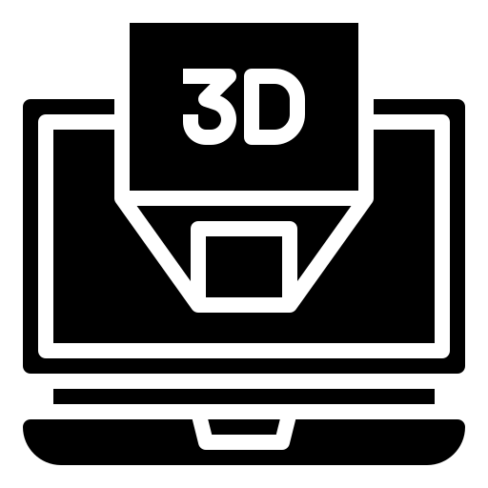


BUSINESS SERVICE PRICES
EXTERIOR & INTERIOR DESIGN
Architectural project $2.541 - $4,666
Interior project $50 per square meter
XR TECHNOLOGIES
VR – virtual reality from $3.500 to $12.000
AR – Augmented Reality $2100 -$6.000 per project
MR – mixed reality $3.000 – $20.000
A hologram N/A
3D MODELING
3D Modeling Used for Product Marketing $15 - $35
3D Modeling for VR and AR $15 - $35 per hour
3D Modeling For 3D Printing $15 - $35 per hour
3D Modeling for Architectural Rendering $15 - $35 per hour
BRANDING & DESIGN
Logo & Branding $1.000 – $4.500
Brand Web Design $500 – $5.000
Custom Design $32-$75/ per hour
Branded Environments $50 per square meter or $32-$75/ per hour
3D VIZUALIZATION
Architectural/Exterior images $1.200
Interior Images $1.200
3D product images $149- $219 per image without modeling
Exterior & Interior animation $3,500 – $4,500 per 60 seconds
3D Product animation $1.000 – $5.000 / 10 – 90 seconds

Slide 19












BUSINESS STARTUP COST
Registration cost
From 300 Eur
Website Manage
From 200 Eur/Month
Computer
From 3800 Eur/One time fee
Ads
Service from 300 Eur/Month + Ads Budget
Software
From 1500 Eur/Per one annually
SEO
Service from 300 Eur/Month
Internet service
From 50 Eur/Month
Social Media Marketing
From 100 Eur to 1200 Eur/Month
Domain/Hosting
From 300 Eur/Year
Content Marketing
From 100 Eur to 415Eur/Month
Offline Marketing
From 435 Eur/Year
Email Marketing
From 100Eur/Month

Slide 20






MARKETING PLAN
The fact that there is stiffer competition in the design industry; there are loads of 3D designers jostling for contracts which is why the company will be to hire some of the best marketing experts to handle sales and marketing.
The sales and marketing team will be recruited based on their vast experience in the real estate market and they will be trained on a regular basis so as to be well equipped to meet their targets and the overall business goal of Wave Break Design company.
Wave Break Design company goal is to grow to become one of the leading design and marketing companies in the different continents which is why the company has mapped out strategies that will help take advantage of the available market and grow to become a major force not only where will be established but also in other countries in the world.
Wave Break Design company is set to make use of the following marketing and sales strategies to attract clients and win design contracts.
Website
SEO
Social Media Marketing
Email Marketing
Strategy
Content Marketing Strategy
Ads
Offline Marketing

Slide 21

OPERATIONAL BUSINESS MODEL
Freelancers and Independent Contractors
The company is planning to hire freelancers, independent contractors, and employees. How many freelancers and independent contractors needed will depend on the size of the project, and how many employees needed - will depend on the employment of the company in the future. The position will be full-time and part-time and allows successful candidates to work from home or maybe in the company offices. Many small business owners prefer to work with independent contractors rather than hiring employees.
Benefits of hiring independent contractors or Freelancer include:
Flexibility in being able to vary hours worked, or paying by project, and not having to pay when work isn't available.
Outsourcing non-essential tasks, like IT and maintenance, so don't have to set up a new department within the company.
Being able to terminate the relationship easily without the paperwork and potential problems that go with firing an employee.
Not having to pay FICA taxes (Social Security and Medicare) in terms of taxes, benefits, and agreements. But must still have a contract (not an employment contract), and there is still paperwork must complete and taxes that must be allocated.
Less hiring paperwork, fewer reports, and payments.
Save money for employee expenses (the office space, equipment, worker’s compensation insurance, unemployment insurance, social security and medicare, health insurance and paid time off)
Working with independent contractors is one of the best alternative ways to grow business and Increase flexibility.
Instead of having to provide full-time employment for every skill set like on a team, the company can work with contractors.
This gives access to everything from high-level network administration to top tier copywriting.
It helps to compete with companies much larger.

Slide 22

OPERATIONAL BUSINESS MODEL
Freelancers and Independent Contractors
Cons of Hiring Independent Contractors or Freelancer Include:
Possible increased risk of audits. Working with contractors has been shown to increase the risk of being audited by the government. Specifically, they’ll be investigating the working relationship between the contractor and business. This underscores the importance of understanding how local and federal government classifies contractors. The key factors are if the business controls what will be done and how it will be done. Essentially, need to keep contractor freedom in mind.
Turnover and Lack of Loyalty. Independent contractors come and go. People are drawn to contracting largely because it gives them greater control over who they work with. Additionally, most businesses hire contractors for short term jobs, which makes it difficult to cultivate loyalty. Contractors can be notoriously disloyal, meaning many can leave if a higher paying project comes along.
Perhaps the core problem with working with contractors is the varying degree of quality will receive. This, in turn, can harm relations with customers. Managing quality control and contractor freedom is quite the balancing act.
More Legality Involved. The company has to make sure contracts and paperwork are in order. Failing to outline expectations in a written agreement could mean that they don’t actually own the copyright to the work. When you work with an employee, work created by them is automatically owned by the organization. With contractors, it must be specifically stated in a legal document.
But, as the hiring employer, there are still some things that must do to hire an independent contractor and start paying that person. While contractors and freelancers are similar, these roles involve different standards and benefits.
Freelancers and independent contractors work for organizations temporarily. They have greater financial and professional independence than the typical employee who receives a salary and benefits for part- or full-time work.

Slide 23
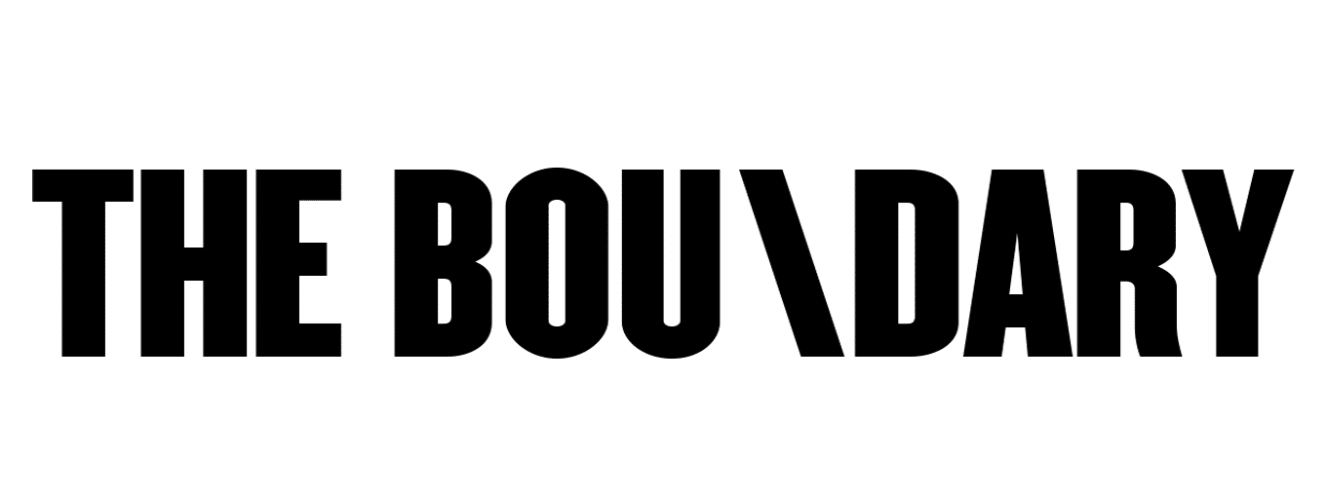
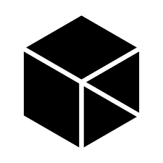
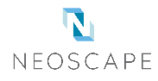


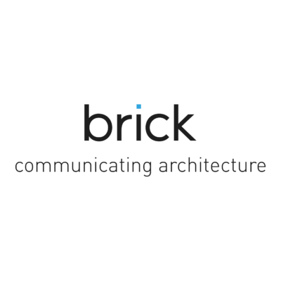


COMPETITORS
COMPANY | Location | Founded | Revenue | Team size | Followers
 | London, United Kingdom and New York, United States | 2014 | $8.3 million (USD) per year | 11 to 48 | Instagram -30.7K Facebook – 17.6K
 | Dubai, United Arab Emirates and Roeselare, Belgium | 2017 | $7million (USD) per year | > 55 | Instagram – 3.9K Facebook – 4.9K
 | Boston, New York and San Francisco, United States | 1995 | 5.5 million (USD) per year | 10 to 100 | Instagram – 3.145K Facebook – 6.239K
 | Huddersfield, United Kingdom | 2003 | 4.5 million (USD) per year | > 50 | Instagram –2.2K Facebook – 4.6K
 | Vancouver (BC, Canada), Toronto (ON, Canada), San Francisco (CA, USA) | 2005 | 2.9 million (USD) | 1-58 | Instagram – 10.8K Facebook – 2.4K
 | Budapest, Hungary | 2012 | 2.8 million (USD) per year | 44 to 51 | Instagram – 36.4K Facebook – 12.3K
 | New York, United States | 2012 | 2 million (USD)per year | > 11 | Instagram – 2.7K Facebook – 119
 | Scotland, United Kingdom | 2011 | < $2 million (USD) per year | > 42 | Instagram –2.7K Facebook – 1.9K
Right at this moment in the international market, Wave Break Design company has the main 22 competitors. The company believes based on competitors' offerings and market analysis will win more profitable jobs due to lack of skills on their part.
Wave Break Design performed an analysis of 22 companies. Most of the larger competitors companies are Boundary Visualisation Limited, Nanopixel BVBA, Neoscape, Inc, Pikcells Ltd, LNG Studios, Designblendz LLC, Brick Visual Solutions Zrt, Noë & Associates, and Architectural CGI. All these companies are from different countries. Most of the larger competitors companies earn from $ 2 million USD to 8.3 million USD per year. The teams of the largest companies consist of 13 to 100 employees. They also all have won various awards for their creations and talents. Actively participates in social networks, public events, exhibitions, seminars.
Competitors were analyzed by website data, services, prices and tools, company information and social media followers. The company has got a wealth of information that it will use to develop a business strategy. The below table shows are the results of the market analysis.
Nanopixel BVBA
Pikcells Ltd
LNG Studios
Noë & Associates

Slide 24
ORGANIZATION CHART
Functional Organization
Founder & Creative Director
Partner & Business Developer
PROJECT MANAGER
3D Modeler
3D Artist CGI
Software Developer
Graphic Designer
Interior designer
3D Artist Animator
Unity Developer
Web Developer
Architectural Designer
3D Artist VFX
XR Software Developer
UI/UX Designer

Slide 25
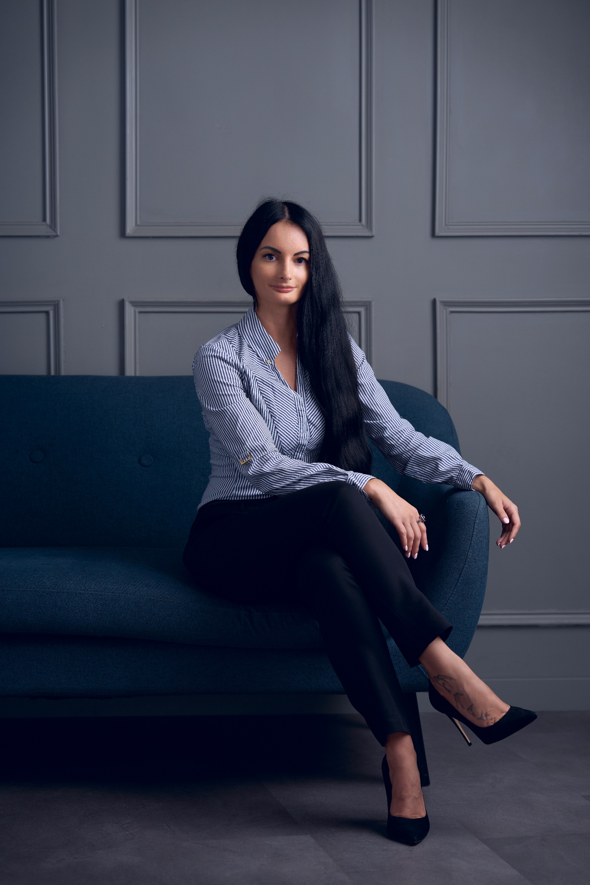


FOUNDER
Dovile graduated from Utena College, Lithuania, in 2011 with a degree in Business Management and Administration.
She has a UCI DCE Studies program – Initiating and Planning Project, Project Management Institute Certificate – Certified Associate in Project Management (CAPM), and The Interior Design Institute Certificate – Interior Design.
She was born and raised in Lithuania, where business ideas began to develop. Still, to focus on broader aspects and innovations of architectural visualization, he moved to North America 7 years ago, where he began to conduct interior design studies and projects. During that time, she gained experience in the interior design and 3D visualization industry.
Her passion for architectural design and graphic design, experience, and a wide range of interest in the latest technologies have led to the broad discovery of ideas and integration of architectural design with XR technologies. All of these pushed for the founding of the Wave Break Design Studio.
Dovile Mackeviciute
Founder | Creative Director

Slide 26
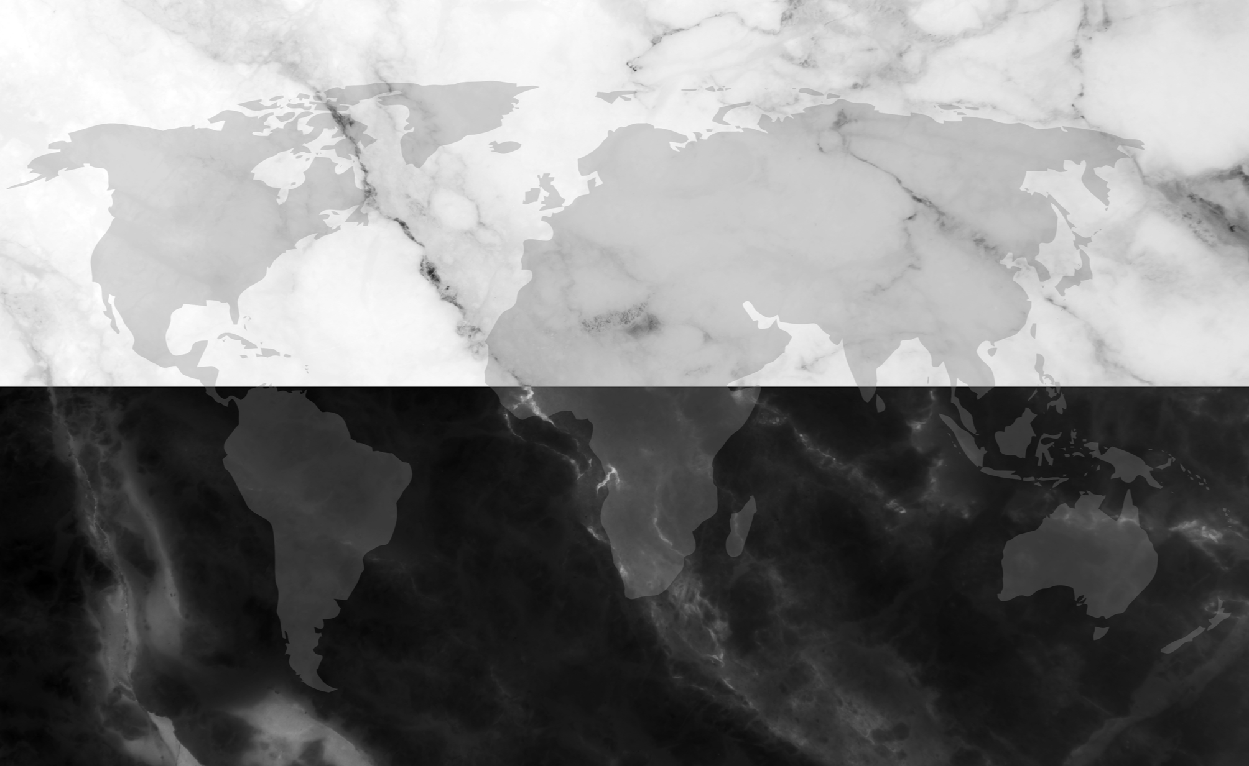
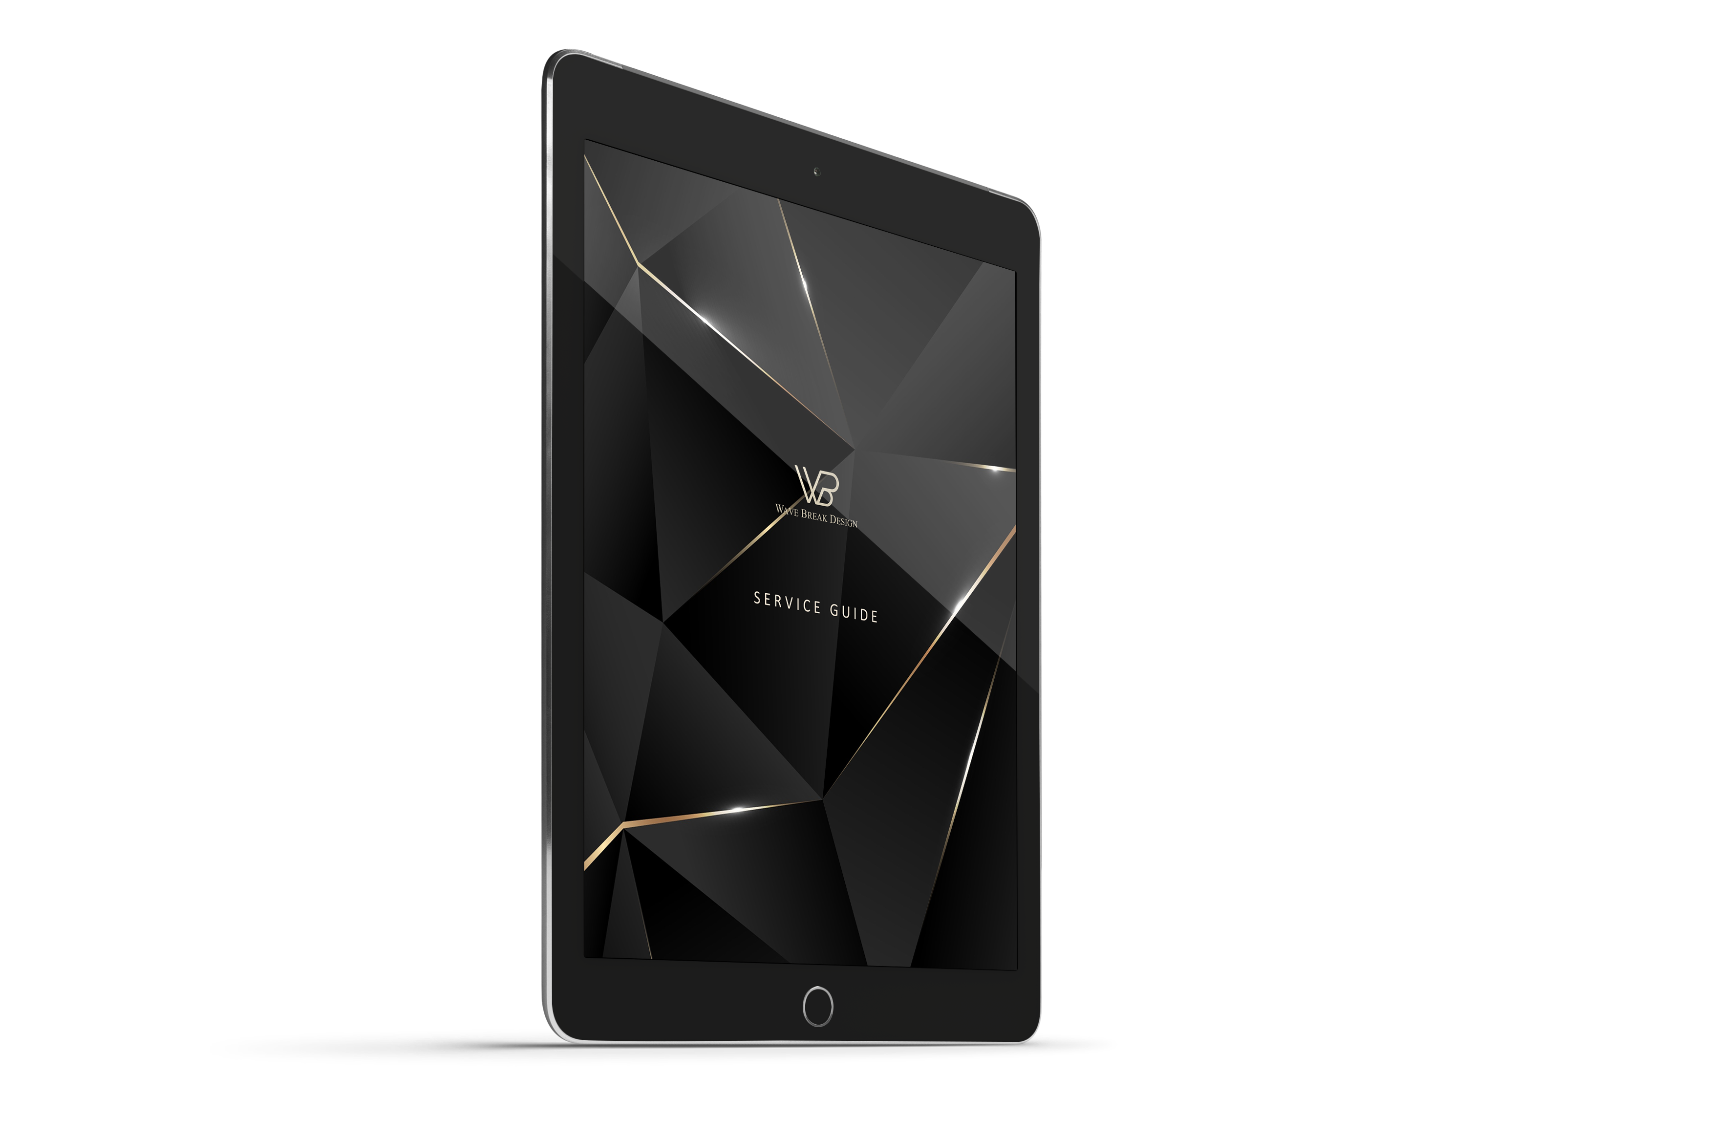
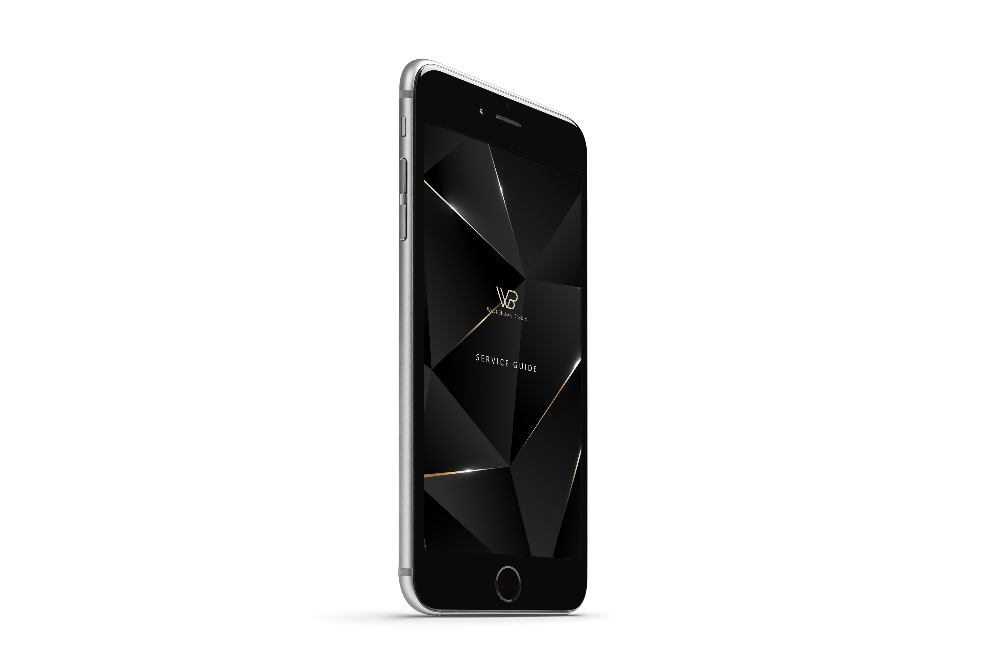
Download our service guide below
DOWNLOAD GUIDE

Slide 27
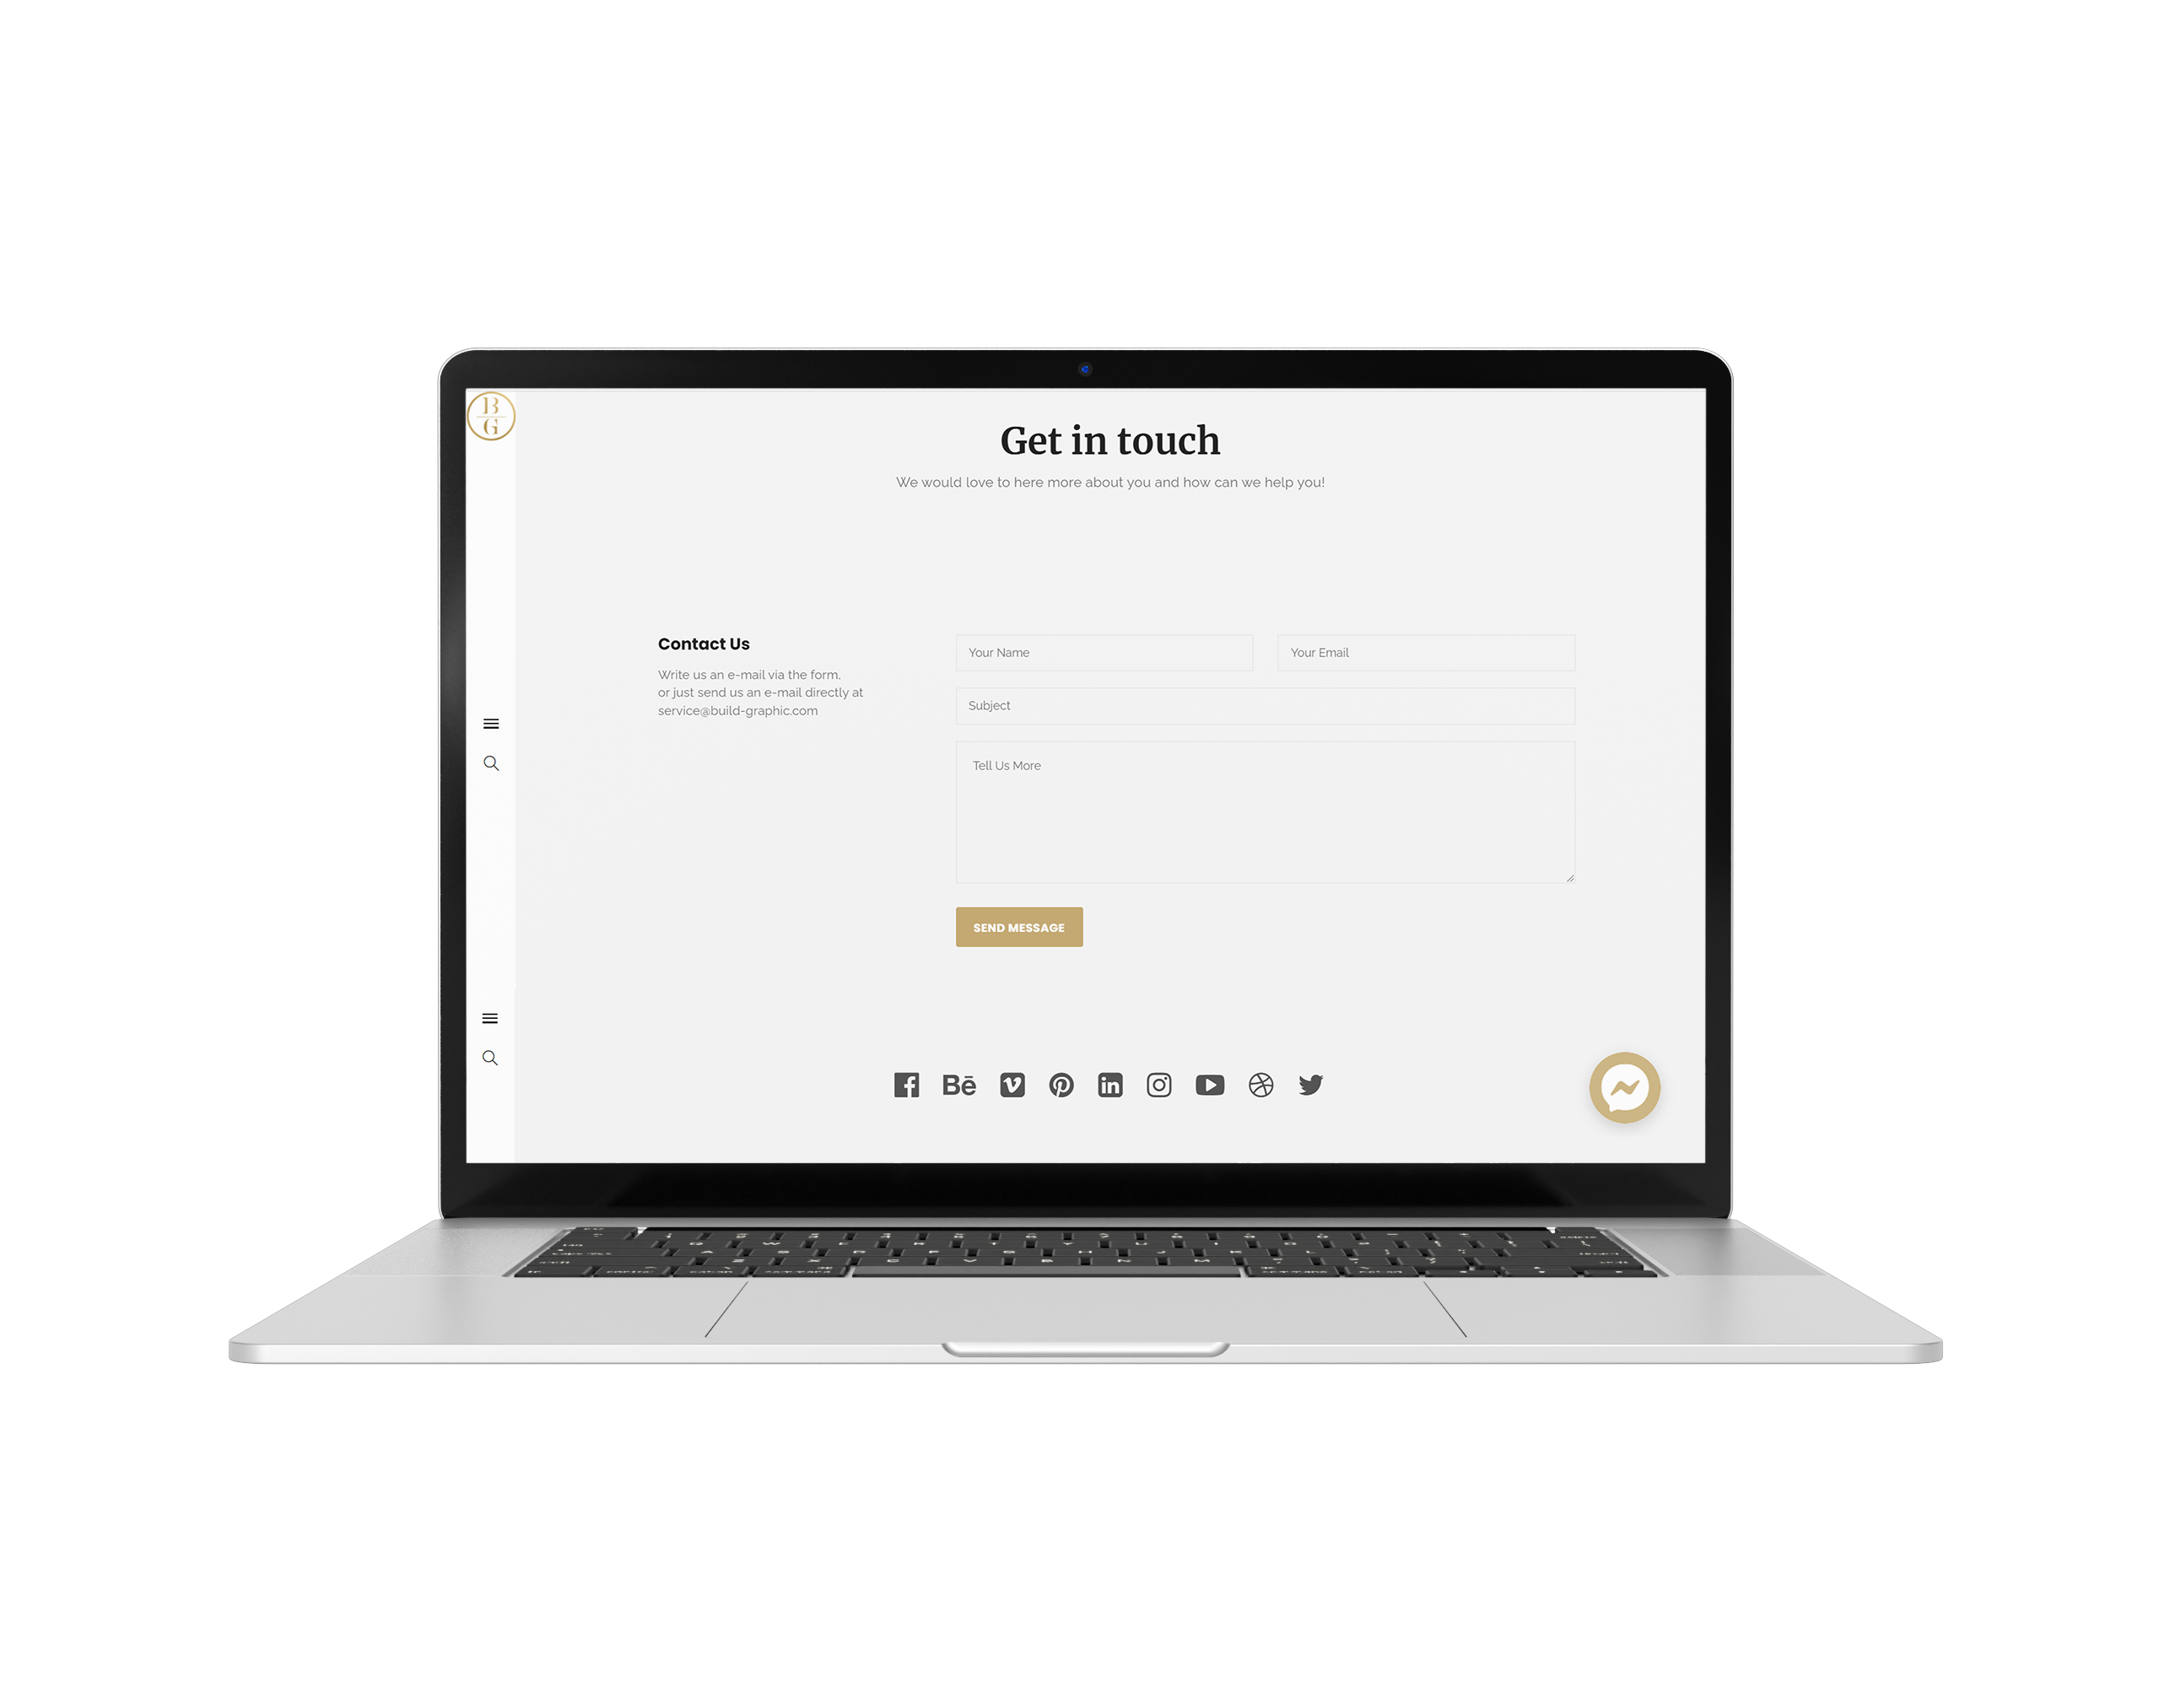
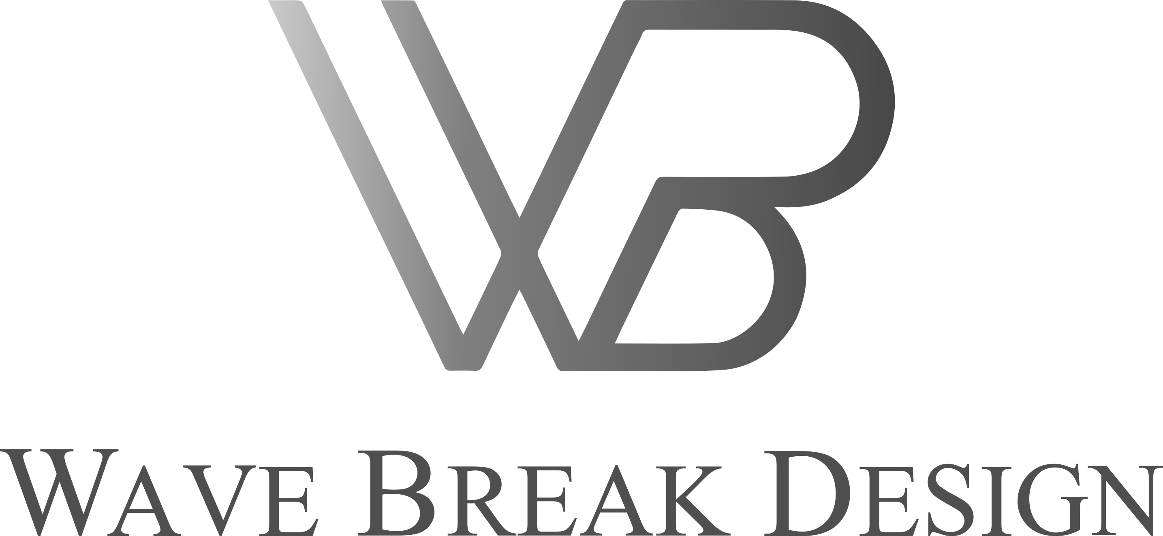
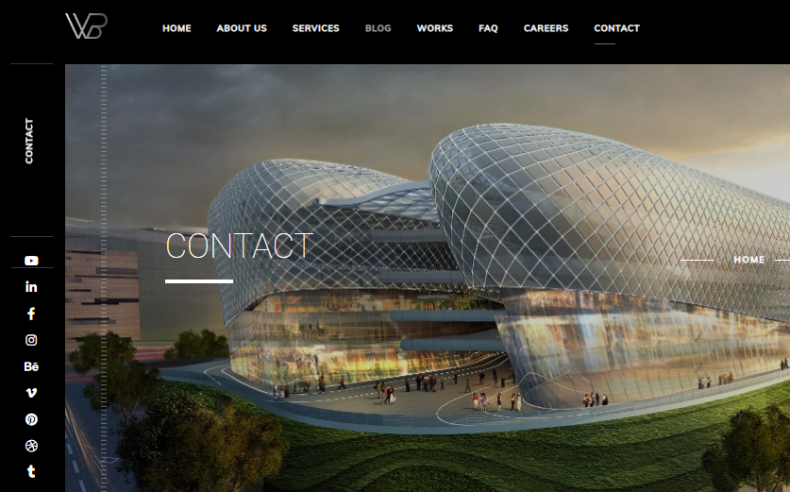


Contacts:
www.wavebreakdesign.com
service@wavebreakdesign.com
CONTACT US

